Slide 1
Mental Health
Fatima Abdulla 10CG
KEY:
*Fun fact
Explanation
Side note

Slide 2
The Science of Brain Control
The brain is the ‘control center’ of the body.
It helps in:
ᴥ Thinking
ᴥ Making decisions
ᴥ Reacting to the environment
ᴥ Emotions
ᴥ Senses
Neurotransmitters (brain chemicals) help the communication between neutrons that keep the brain functioning.
There are billions of neurons (nerve cells) in the brain that are vital as well.
The message sent through the process allow motion and emotion.
*Though the brain contributes to 2% of the body’s weight, it takes up 26% of energy.
F.A.

Slide 3
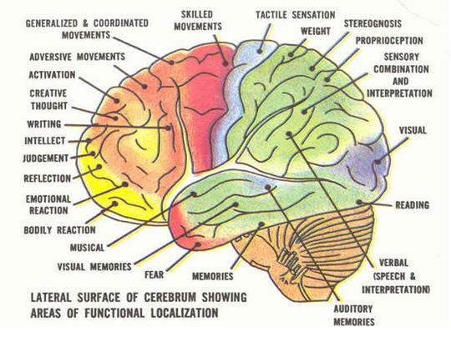
Brain Functioning
Relation to Mental Health
When one of the basic 6 functions of the brain is interfered with, the major effect is a mental illness or disorder.
Behavior
Thinking
Emotion
Perception
Physical Control
Signaling
F.A.
Notes:
Note a few examples in the categories eg fear in emotion and judgment in perception

Slide 4
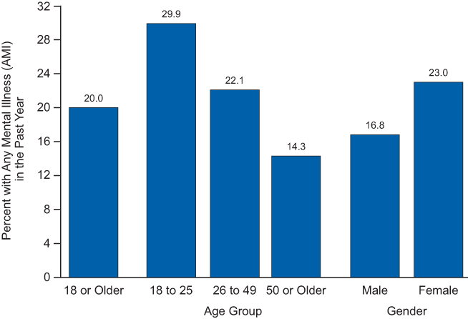
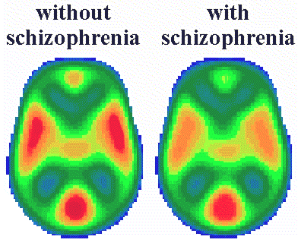
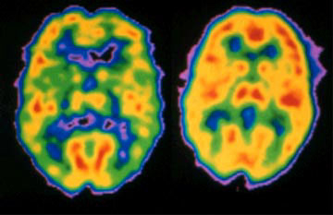
Mentality and Mental Illness: Chemistry
*Schizophrenia effects 2% of the world’s population, which is 140,000,000 people
When the process of the brain’s neurons or hormones in the body, is disturbed, it can lead to a mentality disorder.
Illnesses related to the brain have levels.
OCD.
It can be extreme, to the point you can’t stand a speck of dust, and border on germaphobic,
or
insignificant, so you only have to rearrange things once in a while.
Sadly, sometimes people do not take this seriously and believe the diagnosed are faking it. This is actually false, as shown by scans of the brains of a schizophrenic vs healthy mind.
PET: positron emission tomography
Uses nuclear medicine imaging, to produce 3-dimensional, color images of the functional processes within the human body.
The reason why females are more prone to mental illnesses is because they have more active periods of hormonal imbalances, such as after childbirth or during menstruation.
The most common mental disruption of a female’s brain is depression, which can be very severe.
If the brain is physically damaged, it can cause abnormalities as well, such as holoprosencephaly
F.A.
younger
Notes:
When images of the schizophrenic brain comes up, explain the lack of blood flow to areas which effect the parts underlined in red and the difference between the healthy and schiz brain. Old people: mention the surprise of old people being less mainly because of Alzheimer’s/ Parkinson’s/ Psychosis

Slide 5
Causes
Biological Factors
Psychological Factors
Environmental Factors
Genetics
Infection
Injury
Prenatal
Childhood emotional trauma
Neglect
Early loss
Substance abuse of person or close one
Feeling of anxiety or anger or depression
Social and cultural expectations
You can be born with it, or there can be a trigger such as a traumatic event or stress.
*Psychological distress is barely ever caused by stress alone
Teratogenisis, is the congenital disorder
Neonatal toxicity, which causes behavioral issues
Society’s expectation of skinniness can relate to eating disorders
F.A.
Notes:
Explain prenatal: example: if a mother drinks alcohol during pregnancy, there can be a chance of teratogenisis. Give example of emotional trauma through physical abuse or rape or seeing someone do something aka suicide.

Slide 6
People With Mental Disorders
Insecure
aNgRy
Anti-social
Smart vs Dim
Have one constant
F.A.
Notes:
Smart vs dim→ not necessarily stupid, some can be quite smart. One constant: give example of cousin who has the constant of a type of food and of others who have the constant of an item or so.

Slide 7
Common Illnesses
ADHD
Shizophrenia
Autism
Phobias (Arachnophobia/ Xyrophobia)
Bipolarity
Panic & Anxiety Disorders (Panic Attacks OCD/PTSD)
F.A.
Notes:
ADHD- Attention deficit hyperactivity disorder Xyrophobia- blades

Slide 8
How To Control Mental Health?
HOBBIES
DON’T DO DRUGS OR DRINK
A creative way for the brain to ‘exercise’ itself and remain fit
Not only is it bad for your physical wellbeing, but the chemicals can interact badly with your brain and cause serious damage.
TALK: ASK FOR HELP
You don’t have to join a community for disturbed people to spill your guts, talk to those around you. Keep your relations and be SOCIAL. This helps APD.
EAT RIGHT & BE SAFE
Be aware of your surroundings and stay away from harm. Listen to rules and eat right. What you eat is who you are, and your physical and mental states are related.
Antisocial Personality Disorder
F.A.

Slide 9
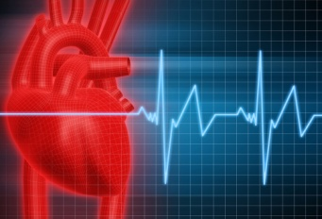

Did You Know?
*1 in 4 people have a neurological mental disorder. 75% of them do not seek medical treatment
*There are more cases of mental illnesses than cases of cancer, diabetes, or heart problems.
>
F.A.
Notes:
Note how the second fact is surprising since we see more of the latter 3 than the mental issur=es and how owning up to a mental problem is fairly new but is more common thzn the others, surprisingly.

Slide 10
Resources
Stanford School of Medicine: http://womensneuroscience.stanford.edu/wellness_clinic/Pregnancy.html
WebMD: http://www.webmd.com/anxiety-panic/mental-health-causes-mental-illness
WHO: Mental Health: http://www.youtube.com/watch?v=L8iRjEOH41c
John Hopkins Medicine: http://www.hopkinsmedicine.org/healthlibrary/conditions/mental_health_disorders/mental_health_disorder_statistics_85,P00753/
Brain & its functioning: HowStuffWorks: http://health.howstuffworks.com/mental-health/depression/facts/the-chemical-connection-to-depression.htm
http://health.howstuffworks.com/human-body/systems/nervous-system/brain-and-mental-health.htm
Discovery Channel:
http://www.discovery.com/tv-shows/curiosity/topics/10-most-diagnosed-mental-disorders.htm
F.A.

